Slide 1

A
PROJECT REPORT
ON
Food Ordering System (Indian Taste)
Submitted to partial fulfillment for the Degree of
Bachelor of Computer Application
(B.C.A SEM-: 6)
Group No: - 03
Submitted To
THE I.N.S.B. INSTITUTE OF INFORMATION
TECHNOLOGY AND MANAGEMENT STUDIES BCA COLLEGE, IDAR
Submitted by
Joshi Akash.B (Exam No:- 97)
Mehta Takshal.H (Exam No:- 173)
Mehta Neel.K(Exam No:-154)
Guided By
Prof. Mukesh Chauhan

Slide 2
PROJECT PROFILE
Project Title | Food Ordering Website
Project Objective | The main objective of this Website is to provide a seamless and user-friendly platform for customers to order food online from their favorite restaurants.
Types Of Application | Website
Front–End | Html, Css, Bootstrap, Javascript, Ajax
Back–End | PHP8.2.4 MySqli Server
Other Tools | Phpmyadmin, VSCODE , AdobePhotoshop, Ms-office
Internal Guide | Prof. Mukesh Chauhan
Time Duration | 90 Days
Submitted To | I.N.S.B. INSTITUTE OF INFORMATION TECHNOLOGY AND MANAGEMENT STUDIES
Developed By | Akash Joshi , Neel Mehta, Takshal Mehta.

Slide 3
SOFTWARE SPECIFICATION(Minimum)
Server side
Operating System | Window 10
Web Server | Apache /2.4.56
Database Server | MySQL 10.24.2
Runtime Environment | PHP/8.2.4
Client side
Operating system | Window 7, 8 ,10, 11 any
Web Browser | Any Compatible Browser

Slide 4
FUNCTIONAL SPECIFICATION
Module:-
Login
Resignation
Forgot password
Places orders
Add to cart
Wallet
Payment
USERS OF THE SYSTEM
In our system there are three users who can work on the system they are:
Admin
User

Slide 5
User specification
Admin:-
Admin can login & then manage the site.
Admin can reset their password.
Admin can manage their profile.
Admin can manage Users.
Admin can manage dish.
Admin can Logout.
User:-
User can register.
User can login.
User can change password.
User can order dish.
User can Logout.

Slide 6
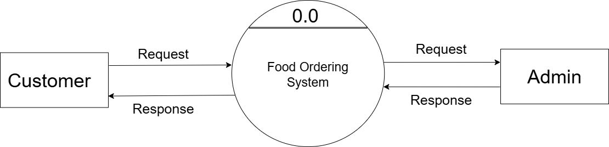
DFD(Data flow diagrams)
0th Level DFD (CONTEXT LEVEL DFD

Slide 7
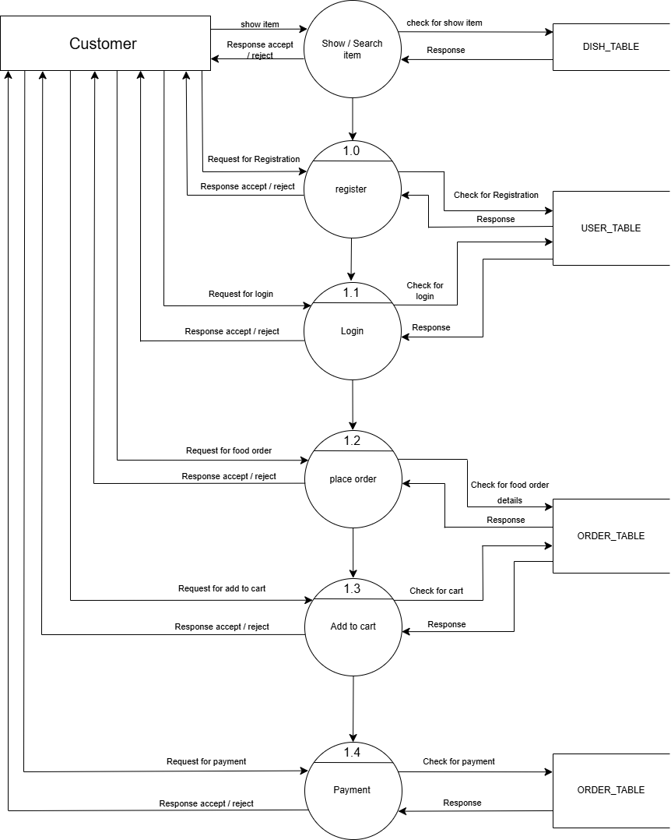
1th Level DFD

Slide 8
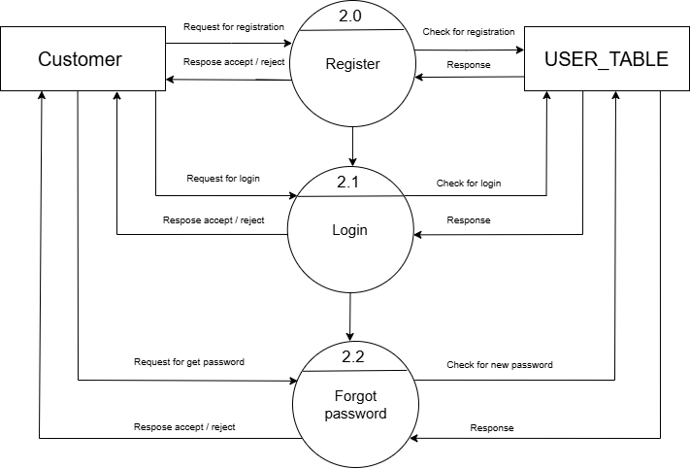
2th Level DFD

Slide 9
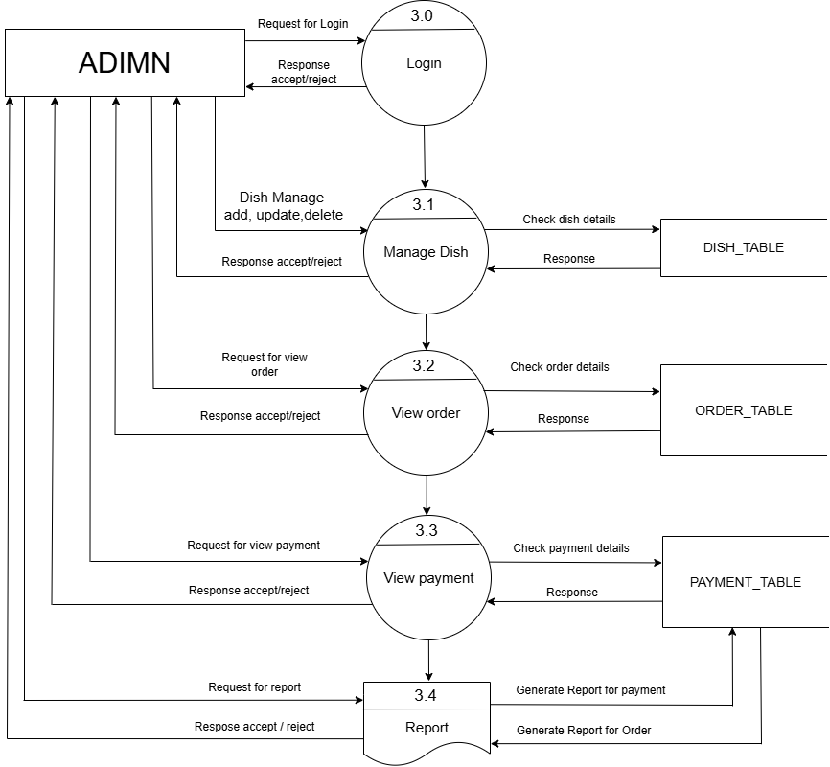
admin- side DFD

Slide 10
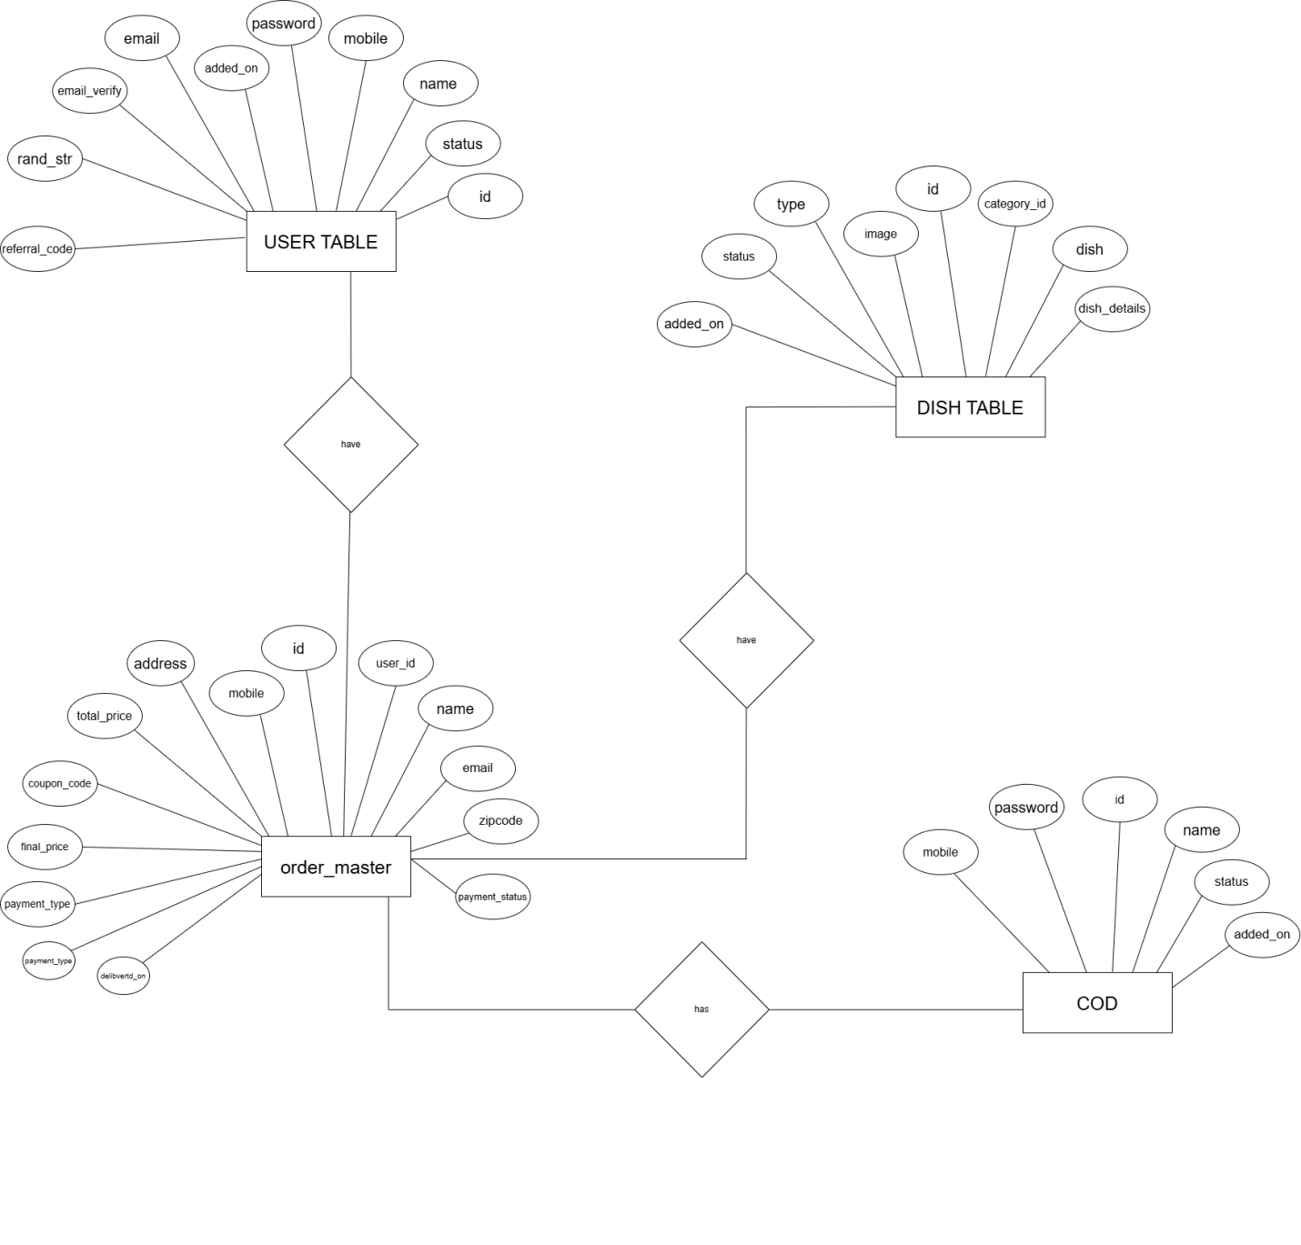
E-R DIAGRAM

Slide 11
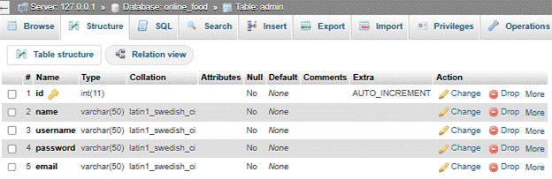
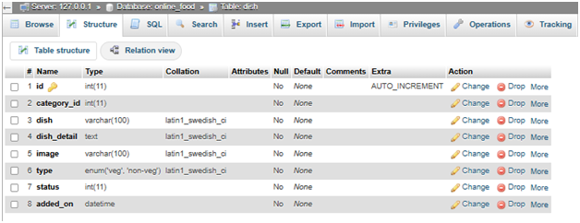
Data Dictionary
Admin-table
Dish-table

Slide 12
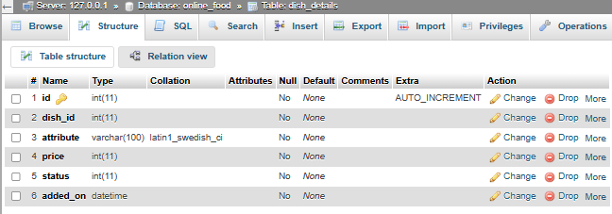
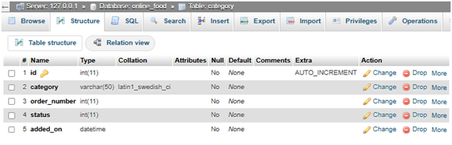
Dish-Details-table
Category-table

Slide 13
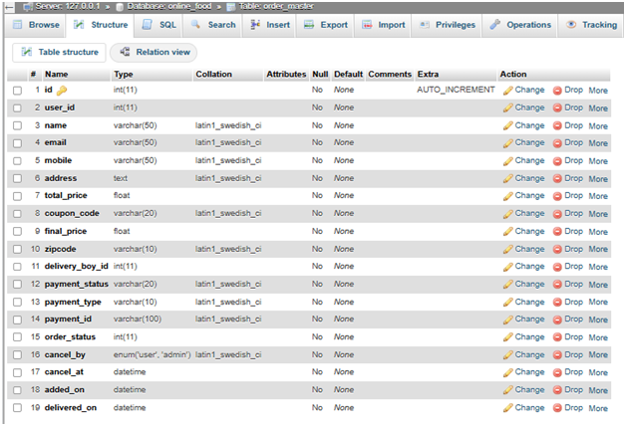
Order-master-table

Slide 14
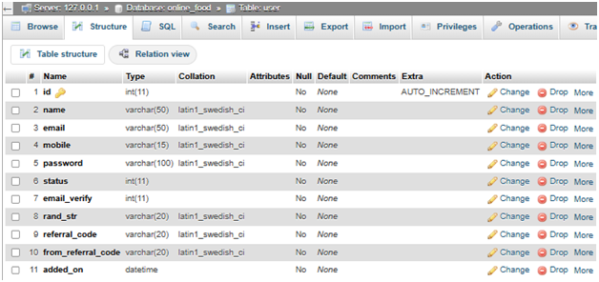
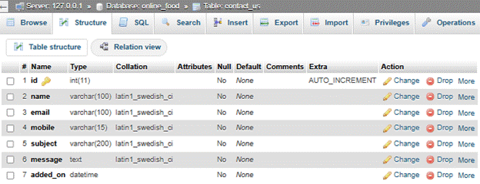
User-table
Contact -us-table

Slide 15
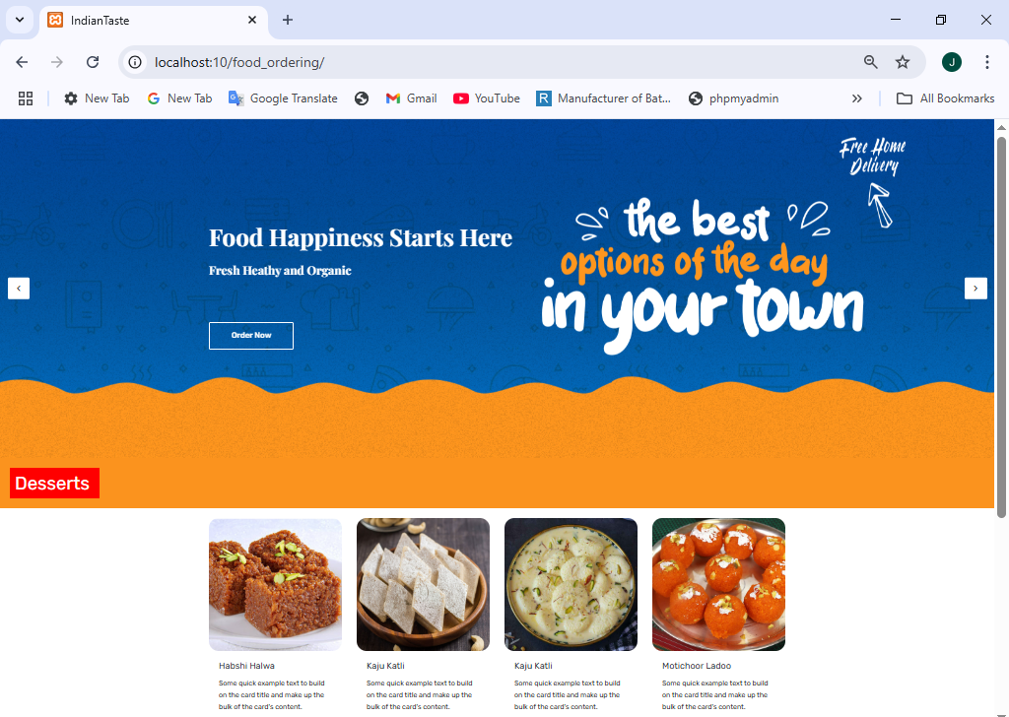
VISITOR INTERFACE DESIGN
Index page

Slide 16
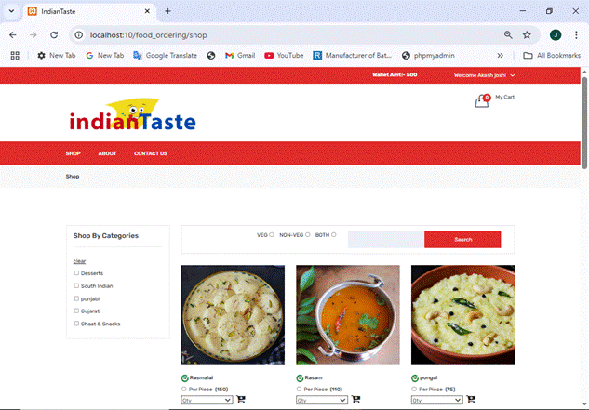
Shop page

Slide 17
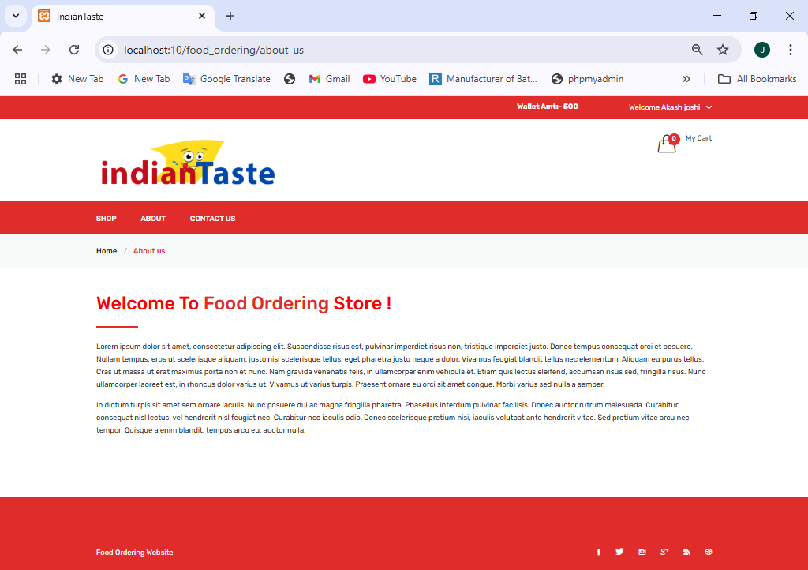
About-us page

Slide 18
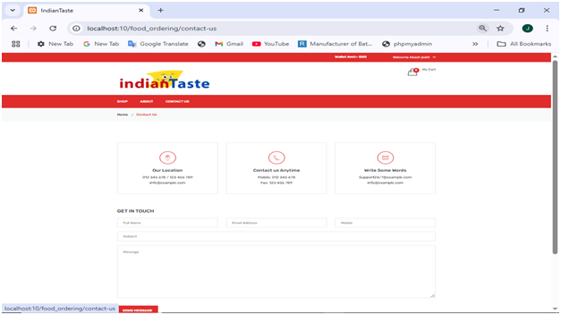
Contact –us page

Slide 19
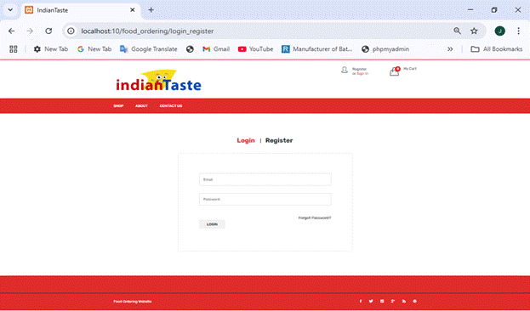
Login page

Slide 20
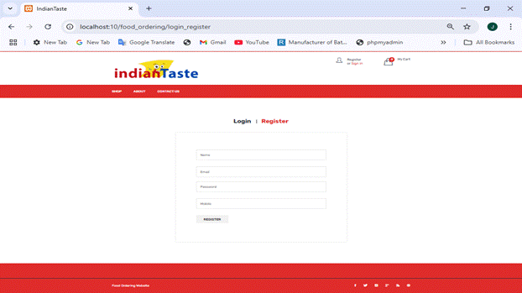
Registration page

Slide 21
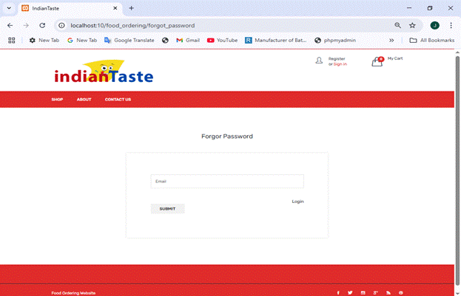
Forgot password page

Slide 22
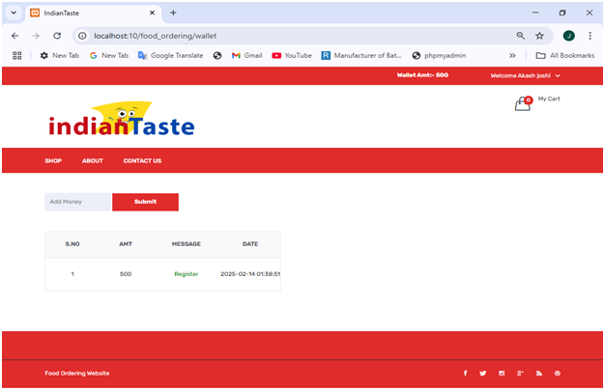
Wallet page

Slide 23
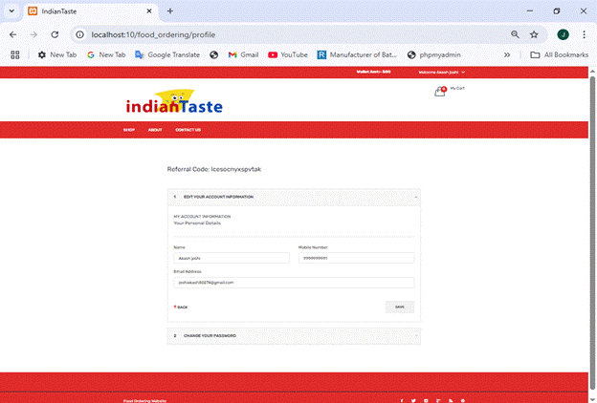
Profile page

Slide 24
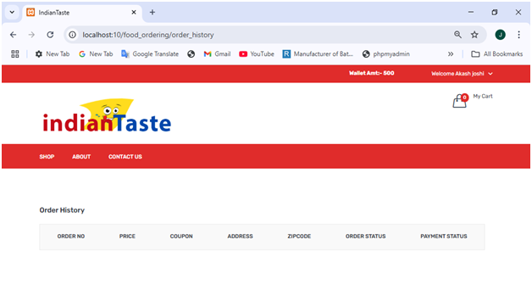
Order history

Slide 25
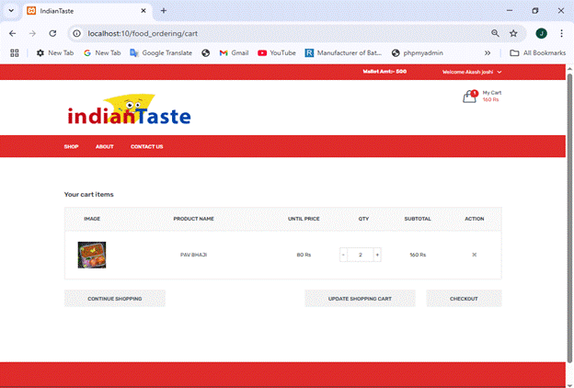
Add to cat app

Slide 26
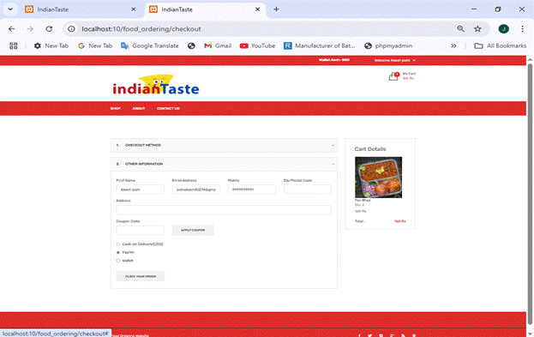
Checkout page

Slide 27
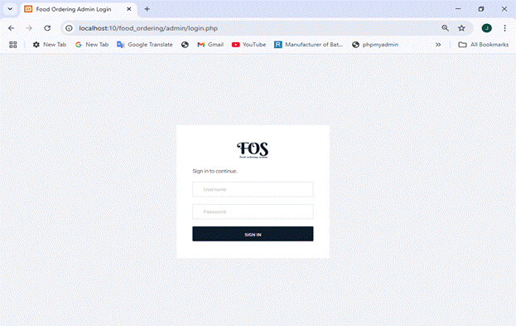
ADMIN INTERFACE DESIGN
Admin login

Slide 28
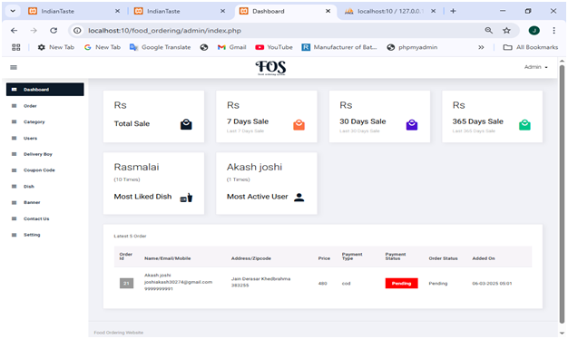
Dashboard page

Slide 29
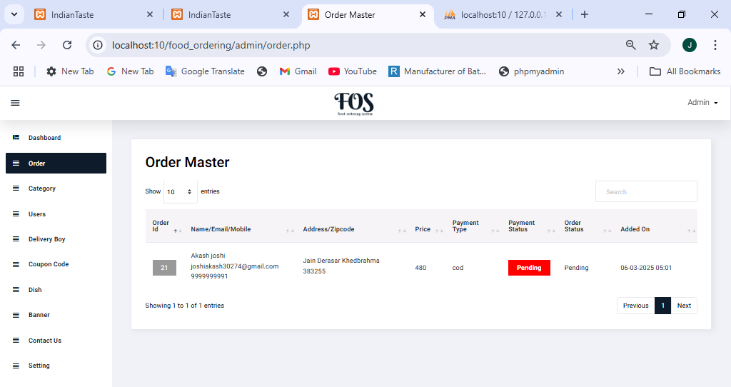
Order page

Slide 30
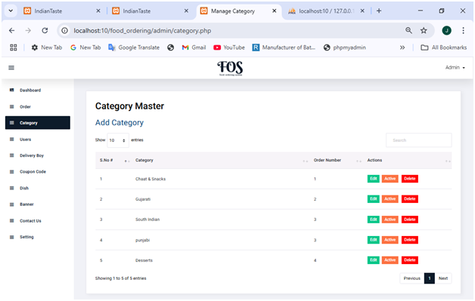
Category page

Slide 31
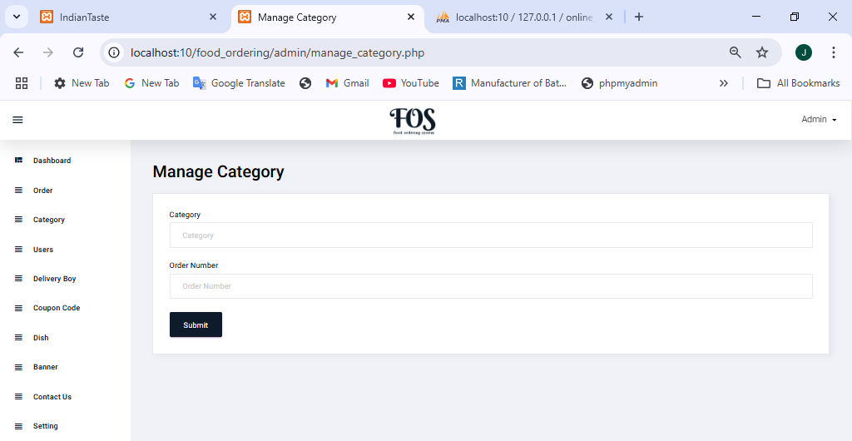
manage-category page

Slide 32
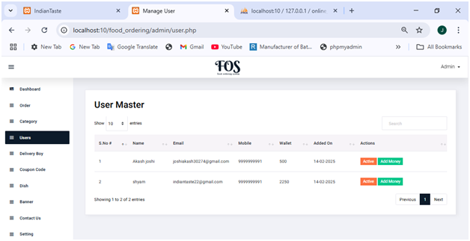
User page

Slide 33
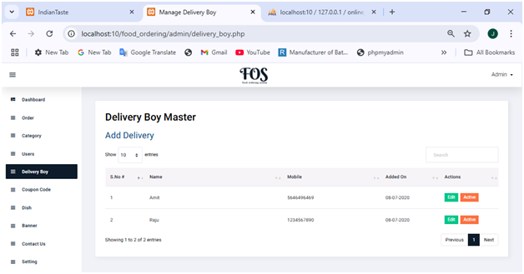
Delivery–boy page

Slide 34
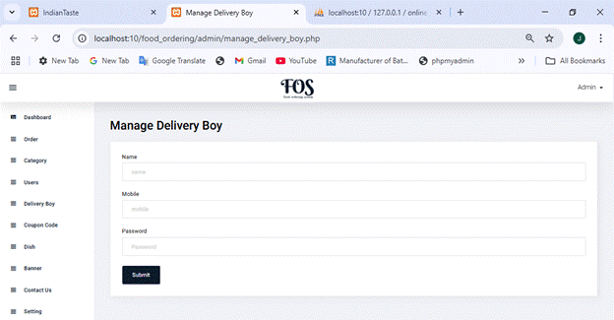
Manage-Delivery–boy page

Slide 35
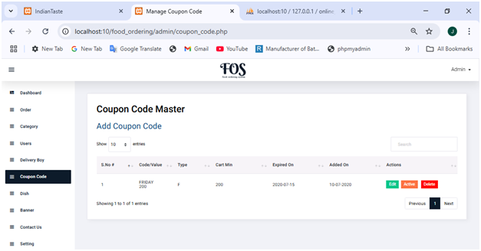
Coupon code master

Slide 36
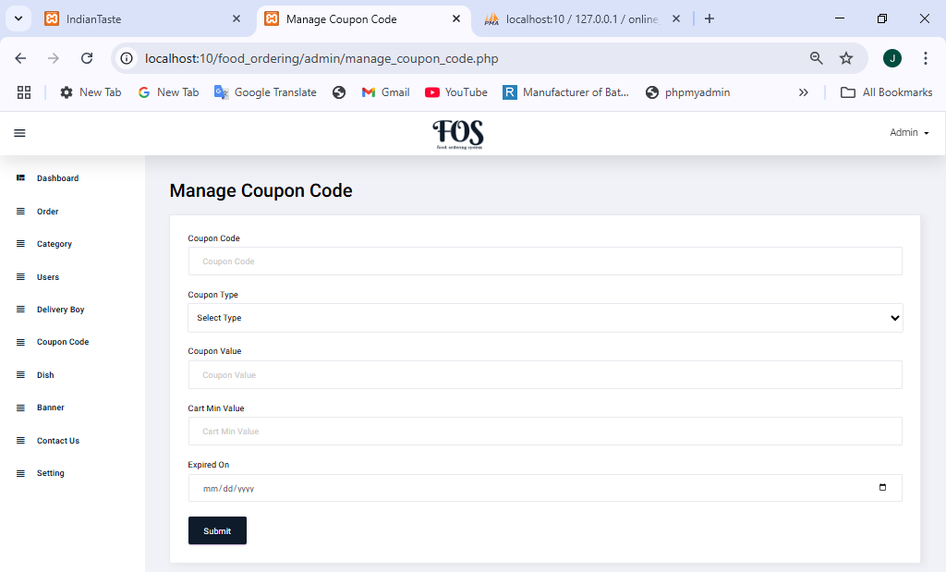
Manage-Coupon code master

Slide 37
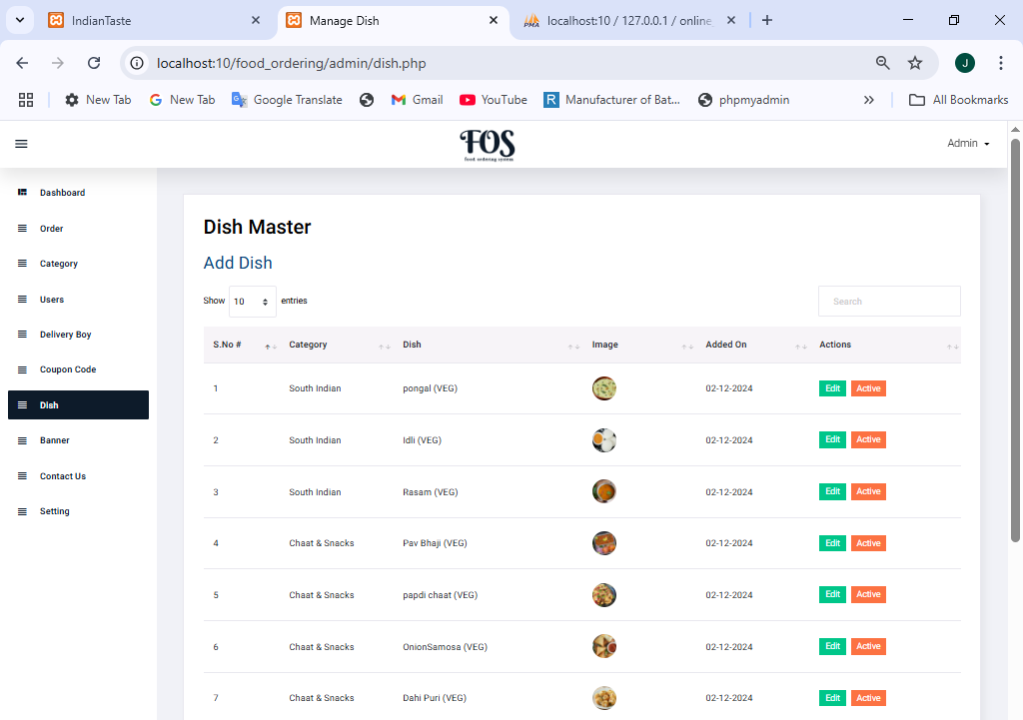
Dish page

Slide 38
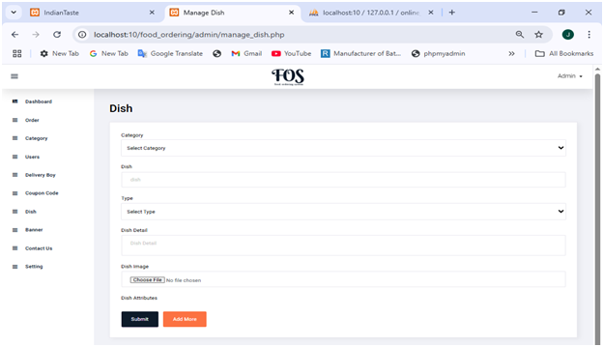
Manage-dish

Slide 39
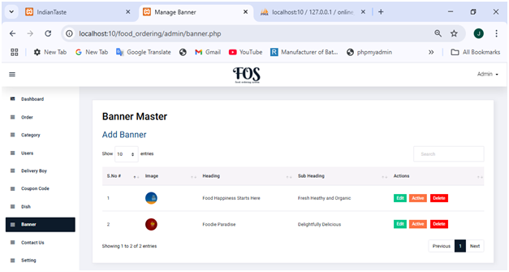
Banner page

Slide 40
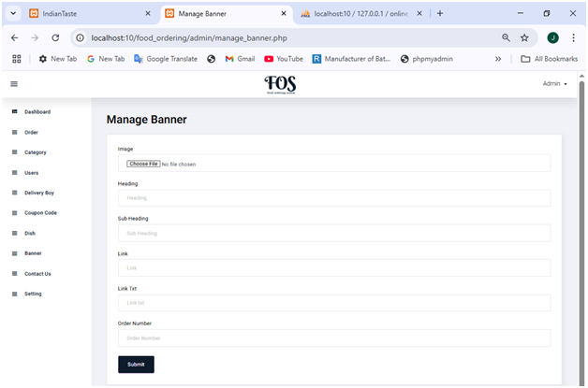
Manage -Banner page

Slide 41
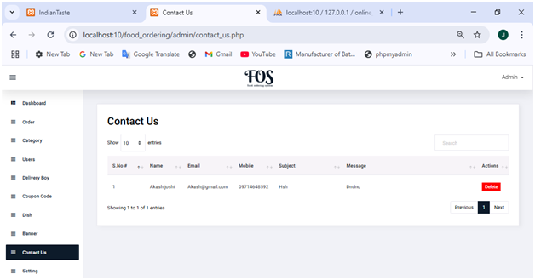
Contact page

Slide 42
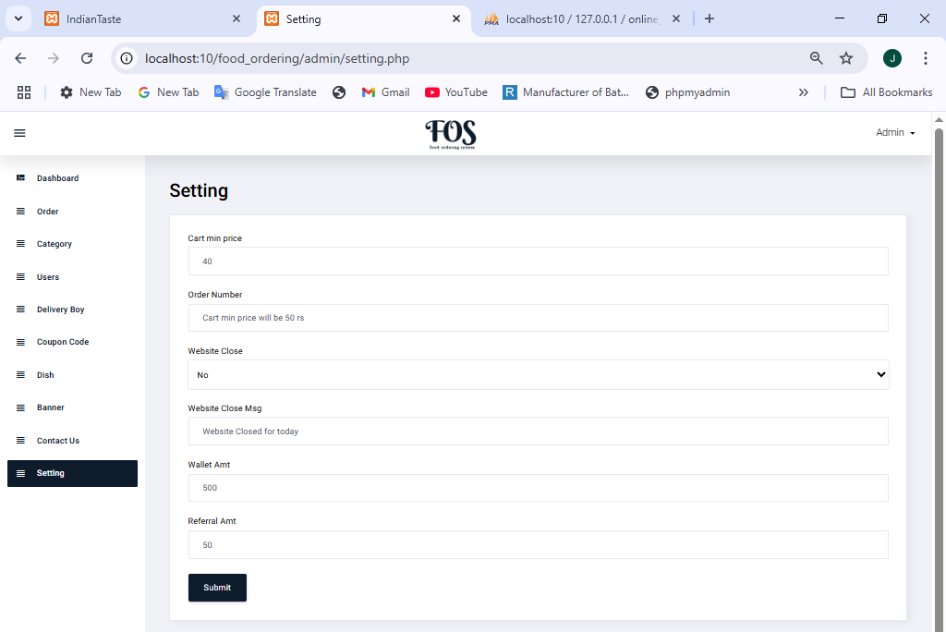
Setting page

Slide 43
BIBLIOGRAPHY
During the project, we referred to various resources that were provided to us for assistance apart fromreceiving help from our guide in the project titled "tribal culture website". The following list provides thebooks and resources that we referred.
No. | Book Name | Description
1. | PHP: The Complete Reference | Author Name:- Steven Holzner Edition:- 1st
2. | JavaScript and JSON Author Name:- Sai Srinivas Sriparasa Essentials | Publisher :- Packet Publishing Limited (26 October 2013) JavaScript and JSON Essentials
3. | Bootstrap | Author Name:- Jake Spurlock Edition:- 1st Publisher:- O'Reilly Media Bootstrap
Libraries
Bootstrap: Documentation. Retrieved from https://getbootstrap.com/
jQuery: Documentation. Retrieved from https https://jquery.com/

Slide 44
WEB REFERENCES
https://www.w3schools.com/
https://stackoverflow.com/questions
https://boostrap.com/
https://chatgpt.com/

